Slide 1
Agent Frameworks
CS6960 MultiModal LLM Agents
Kenneth Marino
Slide credits: Yoav Artzi, Shuyan Zhou, Xinyun Chen, others

Slide 2
Announcements
HW1 due in two weeks
See Syeda’s note in announcements / read the new instructions
Basically just asking you to read the intro unit to the HF Agents tutorial and write some boilerplate code
HW0
Hopefully you’re done
Can give an extension if you recently joined the course
Paper Presentations starting today
Projects
Start thinking of ideas
We’re working on a list of “starter ideas”
Read through papers in area you’re interested in

Slide 3
Recommended Readings
Agent Courses/Tutorials
https://www.shuyanzhou.com/teaching/25fall-590/25fall-590.html
https://rdi.berkeley.edu/adv-llm-agents/sp25
https://agenticai-learning.org/sp25
This week’s papers
Chain-of-Thought Prompting Elicits Reasoning in Large Language Models
ReAct: Synergizing Reasoning and Acting in Language Models
Reflexion: Language Agents with Verbal Reinforcement Learning
Charts-of-Thought: Enhancing LLM Visualization Literacy through Structured Data Extraction
DeepSeek-R1: Incentivizing Reasoning Capability in LLMs via Reinforcement Learning

Slide 4
Lectures Going Forward
Meant to be fairly short / high-level
More an introduction/framing of the topic than a deep dive
Maybe 20-40 mins depending on how much I have to say about the topic
Imperative that you read papers and participate in class discussions to get full breadth of topic

Slide 5
Any Questions

Slide 6
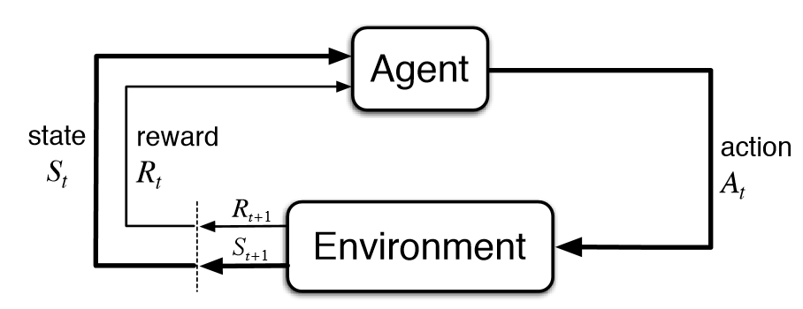
What does VLM agent actually look like?
VLM

Slide 7
What does VLM agent actually look like?
Input: text/images
VLM
Output: text (usually)

Slide 8
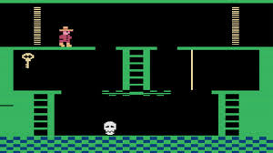
What does VLM agent actually look like?
Input: text/images
VLM
Output: text (usually)

Slide 9
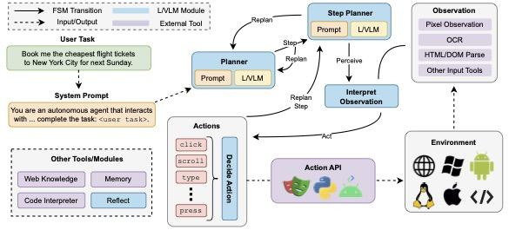
Other “stuff”
Image credit: Farhan Ishmam

Slide 10
Other “stuff”
Frameworks for LLMs to be better at actions (reflect, plan, replan, etc)
Image credit: Farhan Ishmam

Slide 11
Why do this?

Slide 12
What this means for VLM Agents
Basics of environment, maximizing reward, policies, all apply
State/observation given by text image tokens
Output is text (then interpreted as environment actions)
Want to maximize some reward (answer a query, fill out a web form, do some action in the environment)
Most useful algorithms to know
Imitation learning probably most common
When we talk about LLMs, this is exactly the same as Supervised Fine Tuning (SFT)
When we do RL with agents, PPO is most commonly used
VLM agents also often work without any training!
Through prompting frameworks and other methods
Just relies on general ability of the base models!
There will always be a limit on how good this will be / no way to make it better

Slide 13
What this means for VLM Agents
Basics of environment, maximizing reward, policies, all apply
State/observation given by text image tokens
Output is text (then interpreted as environment actions)
Want to maximize some reward (answer a query, fill out a web form, do some action in the environment)
Most useful algorithms to know
Imitation learning probably most common
When we talk about LLMs, this is exactly the same as Supervised Fine Tuning (SFT)
When we do RL with agents, PPO is most commonly used
VLM agents also often work without any training!
Through prompting frameworks and other methods
Just relies on general ability of the base models!
There will always be a limit on how good this will be / no way to make it better
Is there a way to make VLM better without training?

Slide 14
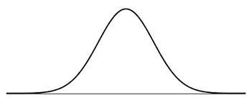
Shift VLM’s distribution
LLM/VLM
Pre-trained on Internet Data
Pretrianing Distribution

Slide 15
Shift VLM’s distribution
LLM/VLM
Pre-trained on Internet Data
Finetuned on some task specific data
SFT
Pretrianing Distribution
Finetuned Distribution

Slide 16
Shift VLM’s distribution
LLM/VLM
Pre-trained on Internet Data
Finetuned on some task specific data
Use prompting to shift the input to get a different distribution
SFT
Prompting
Pretrianing Distribution
Finetuned Distribution
Prompting

Slide 17
Prompting!
Simple way to turn LLMs into task-specific models
You benefit from the rich representations of the LLM
Finetuned on some task specific data
LLMs offer a completely new mode of operation that does not require any changes to its parameters: prompting
With or without annotated examples: zero-shot or in-context learning (few-shot)
With or without intermediate reasoning steps: chain-of-thought prompting
Prompt to Act and plan - ReAct
Prompt to self-correct mistakes - Reflexion
Material from Yoav Artzi

Slide 18
Zero-shot Prompting
x = the movie’s acting could’ve been better, but the visuals and directing were top-notch.
Input: single unlabeled example x
Output: the label y
The task (and output) can be any text-to-text task: classification, summarization, translation
Pre-processing: wrap x in a verbalizer template
The template controls the output
v(x) = Review: the movie’s acting could’ve been better, but the visuals and directing were top-notch.
Out of positive, negative, or neutral this review is
LLM
neutral
y
Material from Yoav Artzi

Slide 19
Zero-shot Prompting
x = the movie’s acting could’ve been better, but the visuals and directing were top-notch.
Input: single unlabeled example x
Output: the label y
The task (and output) can be any text-to-text task: classification, summarization, translation
Pre-processing: wrap x in a verbalizer template
The template controls the output
We’ve made a task more accurate by prompting the LLM with information about how we want it to perform the task
In this case - what is the output space we want for the task
Can instantly improve performance with no additional data (zero-shot, zero extra data)
v(x) = Review: the movie’s acting could’ve been better, but the visuals and directing were top-notch.
Out of positive, negative, or neutral this review is
LLM
neutral
y
Material from Yoav Artzi

Slide 20
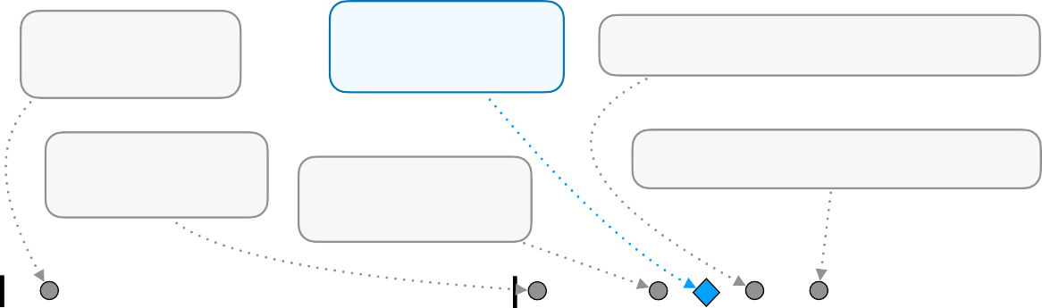
Sensitivity and Variability
Prompts can even be sensitive to minor cosmetic changes
Can influence performance in unexpected ways
Can think of them as (very complex) hyper-parameters
Modified separator
Original formatting
Modified spacing between fields
Passage:<text> Answer:<text>
Passage: <text> Answer: <text>
Passage: <text> Answer: <text>
Modified casing
Modified separator and spacing
Passage <text> Answer <text>
PASSAGE <text> ANSWER <text>
PASSAGE: <text>
ANSWER: <text>
Task Accuracy
₀ 0.036 0.804
Performance Spread Among Plausible Formats
1
Figure 1: Slight modifications in prompt format templating may lead to significantly different model performance for a given task. Each <text> represents a different variable-length placeholder to be replaced with actual data samples. Example shown corresponds to 1-shot LLaMA-2-7B perfor- mances for task280 from SuperNaturalInstructions (Wang et al., 2022). This StereoSet-inspired task (Nadeem et al., 2021) requires the model to, given a short passage, classify it into one of four types of stereotype or anti-stereotype (gender, profession, race, and religion).
Material from Yoav Artzi
[Sclar et al. 2023]

Slide 21
Sensitivity and Variability
Prompts can even be sensitive to minor cosmetic changes
Can influence performance in unexpected ways
Can think of them as (very complex) hyper-parameters
This is one reason prompting can be a less idea strategy
May be better to SFT/RL train for more robust agents, avoid prompt hyperparameter search
Modified separator
Original formatting
Modified spacing between fields
Passage:<text> Answer:<text>
Passage: <text> Answer: <text>
Passage: <text> Answer: <text>
Modified casing
Modified separator and spacing
Passage <text> Answer <text>
PASSAGE <text> ANSWER <text>
PASSAGE: <text>
ANSWER: <text>
Task Accuracy
₀ 0.036 0.804
Performance Spread Among Plausible Formats
1
Figure 1: Slight modifications in prompt format templating may lead to significantly different model performance for a given task. Each <text> represents a different variable-length placeholder to be replaced with actual data samples. Example shown corresponds to 1-shot LLaMA-2-7B perfor- mances for task280 from SuperNaturalInstructions (Wang et al., 2022). This StereoSet-inspired task (Nadeem et al., 2021) requires the model to, given a short passage, classify it into one of four types of stereotype or anti-stereotype (gender, profession, race, and religion).
Material from Yoav Artzi
[Sclar et al. 2023]

Slide 22
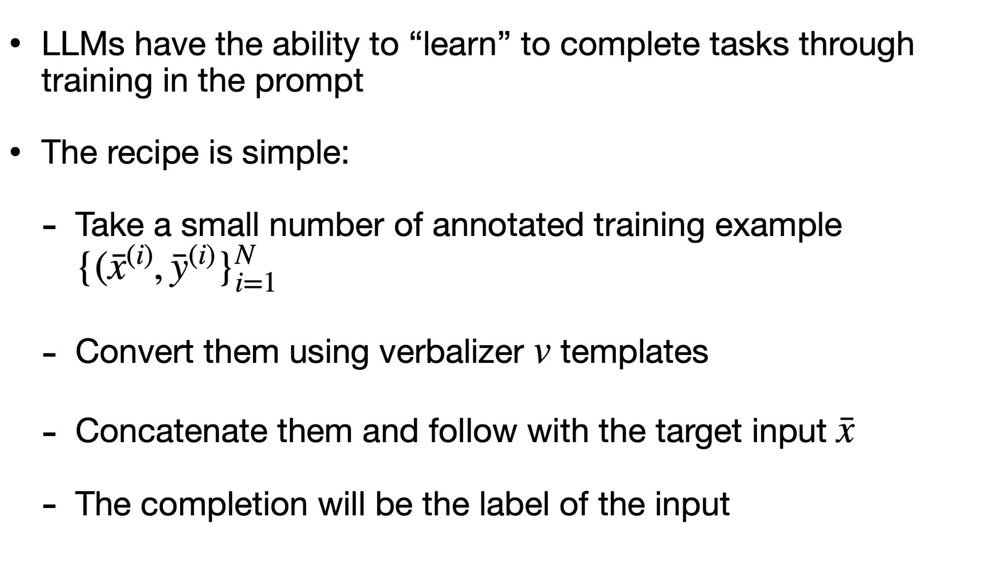
Few-shot / In-context Learning (ICL)
x = the movie’s acting could’ve been better, but the visuals and directing were top-notch.
Review: The cinematography was stellar; great movie! Sentiment (positive or negative): positive
Review: The plot was boring and the visuals were subpar.
Sentiment (positive or negative): negative
Review: The movie’s acting could’ve been better, but the visuals and directing were top-notch.
Sentiment (positive or negative):
LLM
positive
y
Material from Yoav Artzi

Slide 23
In-context Learning (ICL)
Providing ICL examples almost always leads to significant improvements
Benefits tend to diminish with more examples
Material from Yoav Artzi

Slide 24
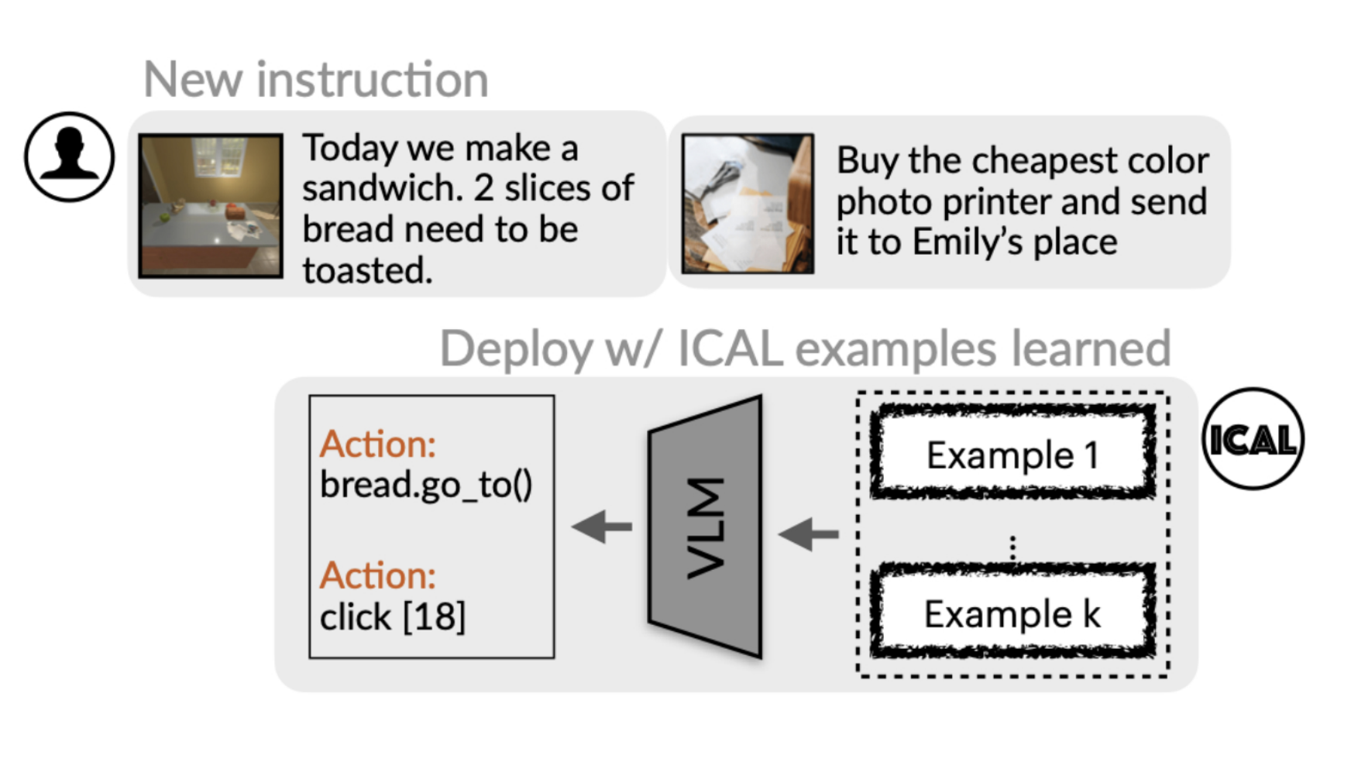
ICL in Agents
Gabriel Sarch, Lawrence Jang, Michael Tarr, William W Cohen, Kenneth Marino, Katerina Fragkiadaki. “VLM agents generate their own memories: Distilling experience into embodied programs of thought." NeurIPS 2024.

Slide 25
Chain-of-thought (COT) Prompting
Can we get agents to “think” through decisions?
Some tasks require multiple reasoning steps
Directly generating the answer requires the model internally do the reasoning steps (or shortcut somehow)
It is empirically useful to:
Show the model examples of the reasoning steps through ICL
And then have it explicitly generate the reasoning steps
Material from Yoav Artzi

Slide 26


Chain-of-thought (COT) Prompting
Chain-of-Thought Prompting
Model Input
Standard Prompting
Model Input
Q: Roger has 5 tennis balls. He buys 2 more cans of tennis balls. Each can has 3 tennis balls. How many tennis balls does he have now?
Q: Roger has 5 tennis balls. He buys 2 more cans of tennis balls. Each can has 3 tennis balls. How many tennis balls does he have now?
A: The answer is 11.
A:
Roger started with 5 balls. 2 cans of 3 tennis balls
each is 6 tennis balls. 5 + 6 = 11.
The answer is 11.
Q: The cafeteria had 23 apples. If they used 20 to make lunch and bought 6 more, how many apples do they have?
Q: The cafeteria had 23 apples. If they used 20 to make lunch and bought 6 more, how many apples do they have?
Model Output
Model Output
A: The answer is 27.
A:
The cafeteria had 23 apples originally. They used
20 to make lunch. So they had 23 - 20 = 3. They
bought 6 more apples, so they have 3 + 6 = 9.
The
answer is 9.
[Wei et al. 2022]

Slide 27
Chain-of-thought (COT) Prompting
Chain-of-Thought Prompting
Model Input
Standard Prompting
Model Input
This is covered in one of the presentations today, so not going too deep
Bottom line: prompting alone can encourage LLM to reason better!
Q: Roger has 5 tennis balls. He buys 2 more cans of tennis balls. Each can has 3 tennis balls. How many tennis balls does he have now?
Q: Roger has 5 tennis balls. He buys 2 more cans of tennis balls. Each can has 3 tennis balls. How many tennis balls does he have now?
A: The answer is 11.
A:
Roger started with 5 balls. 2 cans of 3 tennis balls
each is 6 tennis balls. 5 + 6 = 11.
The answer is 11.
Q: The cafeteria had 23 apples. If they used 20 to make lunch and bought 6 more, how many apples do they have?
Q: The cafeteria had 23 apples. If they used 20 to make lunch and bought 6 more, how many apples do they have?
Model Output
Model Output
A: The answer is 27.
A:
The cafeteria had 23 apples originally. They used
20 to make lunch. So they had 23 - 20 = 3. They
bought 6 more apples, so they have 3 + 6 = 9.
The
answer is 9.
[Wei et al. 2022]

Slide 28

Thinking without Prompting?
Can we train LLMs to think through their reasoning?
Will hear more about this later
Use RL to train models to do reasoning

Slide 29
Many classes of inference-time LLMs
Are there inference-time / prompting techniques for agents?

Slide 30
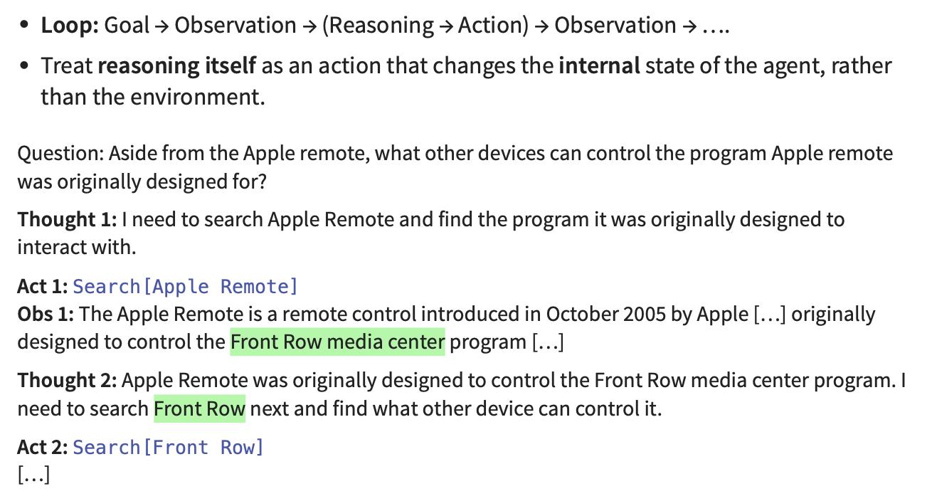
ReAct (Yao et al 2023)
Slides from Shuyan Zhou

Slide 31
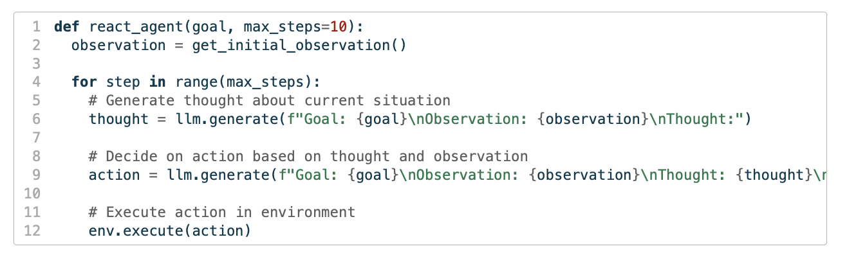
ReAct (Yao et al 2023)
ReAct eﬀectively defines a straightforward for loop
Slides from Shuyan Zhou

Slide 32
ReAct (Yao et al 2023)
ReAct eﬀectively defines a straightforward for loop
Slides from Shuyan Zhou

Slide 33
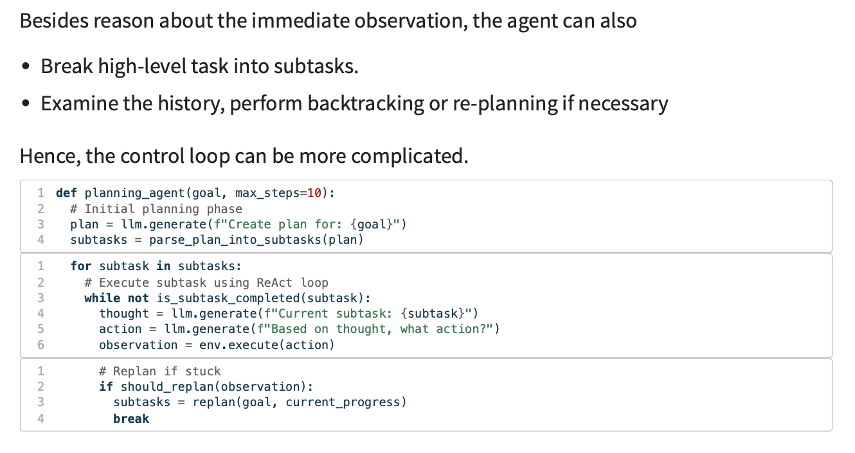
Planning Beyond ReAct
Slides from Shuyan Zhou

Slide 34
Correcting mistakes
Can VLM agents recognize/fix their own mistakes
Can they reflect and figure out where they went wrong

Slide 35
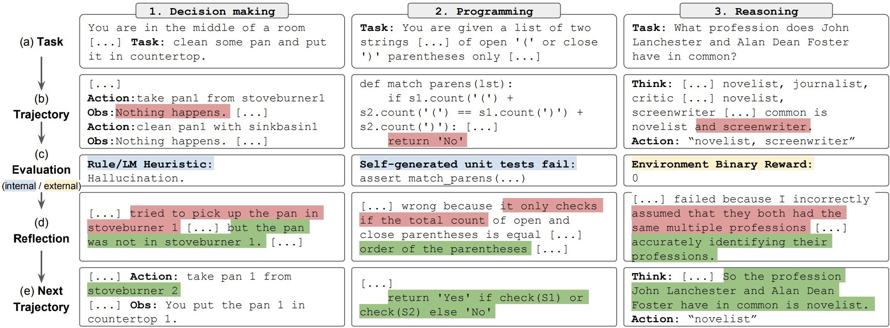
Reflexion and Self-Refine
LLM generates feedback on its output. Use external evaluation when available.
LLM self-refines its output given both internal feedback and external evaluation.
Shinn et al., Reflexion: Language Agents with Verbal Reinforcement Learning, NeurIPS 2023. Madaan et al., Self-Refine: Iterative Refinement with Self-Feedback, NeurIPS 2023.
Slides from Xinyun Chen

Slide 36
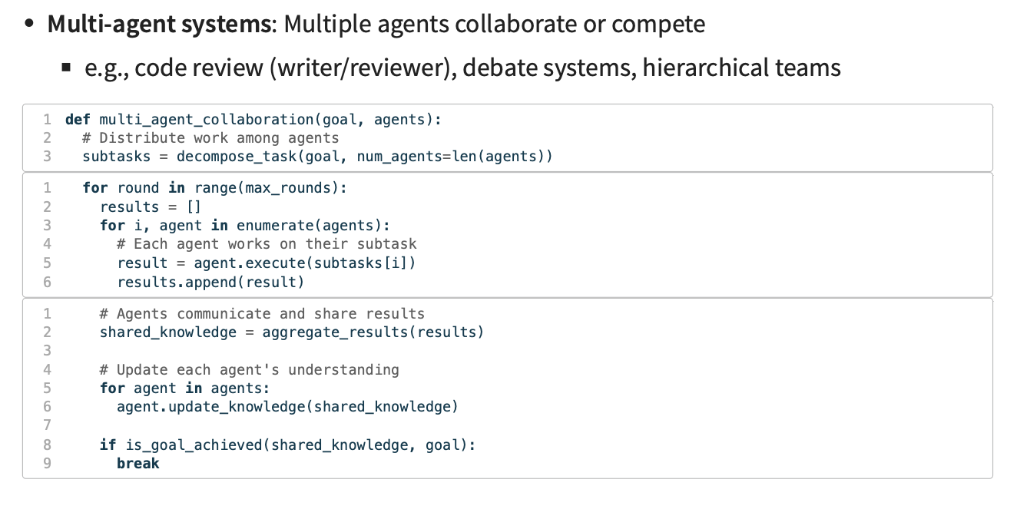
Beyond Singe Agent
Slides from Shuyan Zhou

Slide 37
Takeaways
We want some way to get VLMs/LLMs more in distribution for agent tasks
Ideally: SFT/RL can do this
In a pinch, prompting techniques very effective
Get agents in distribution
Zero-shot prompting
In context Learning
Get agents to think
With prompting in context (CoT)
With RL training (DeepSeek)
Prompt agents to behave more like agents
Think/Act/Observe ReAct
Reflect on mistakes - Reflexion

Slide 38

Any Questions
Questions

Slide 39
Now for the presentations!

